Slide 1
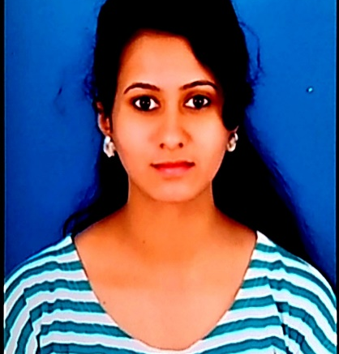



SUPRIYA V R
Master of Computer Application
Computer science : 2019 -2020
Analyst/Software Engineer
Skills
BANGALORE
supriya-v-r.supriya-v-r@capgemini.com
C# | Basics, OOPS, Exception Handling, Collections & Generics, Delegates, Events , File IO and Serialization
.NET Framework | ADO.NET with Entity Framework And LINQ,ASP.NET with MVC5, ASP.NET CORE WEB API.
ADO.NET | Basics, Connected and Disconnected Architecture
RDBMS | Basic And Advanced Using SQL Server
UI Technology | HTML 5, CSS And JavaScript
Tools | Git ,GitHub
Add On Skills | Communication , Team management
+91 7899972866
A4
EMP ID-46209801
Full Stack Developer
• Hands on experience on C#,ADO.NET,LINQ,Entity framework,Sql Server,ASP.NET MVC5 with WEB API,ASP.NET CORE WEB API.
•Good Knowledge of java programming.
•Good in developing web pages using HTML, CSS.
•Currently learning on iTransform-Microsoft .Netcore and Azure fundamental
• Full Stack developer with React and Full Stack .NET Developer
• Hands on experience in developing web pages using HTML5, CSS3, Object Oriented Java script, ES6, JSON, XML. Good understanding of Document Object Model (DOM) and DOM Functions.
• Proficient in creating Single page Web Application in React with Authentication with routing.
ONLINE RAILWAY RESERVATION SYSTEM
Case study of OnlineRailwayReservationSystem along with API Gateway, Swagger,responsive UI with HTML5, CSS and React used as User Interface.
Three layered architecture which includes a Data Access Layer, Business Logic Layer using C#, ASP.NET CORE WEB API. , SQL Server . Exception Layer handled the exceptions.
Classes in all layers were designed using C# and ASP.NET CORE WEB API. Database was designed in SQL Server.
Connecting the application with database was done using ASP.NET CORE WEB API.
Check out my work on project video link
Check out my work on GitHub

